Slide 1
Marflix Intelligence
Group 1 Project
IST 722: Data Warehousing
08/08/2025
TEAM: ASHISH KUSHWAHA, RIANNE PARKER, SEMI BABAFEMI, MARJAN ABEDINI

Slide 2
Project
Goal:
Analyze company sales for both fudgeflix and fudgemart.
Deliverables:
Project Charter Document
Dimensional Data Model
Consolidated fact table for sales
Shared dimension tables
SQL scripts for tables and ELT
Analysis measures
Powerpoint Presentation

Slide 3
Team Roles
ASHISH KUSHWAHA
RIANNE PARKER
Data Architect (PM)
Data Engineer (PM)
SEMI BABAFEMI
MARJAN ABEDINI
BI Developer
BI Developer

Slide 4
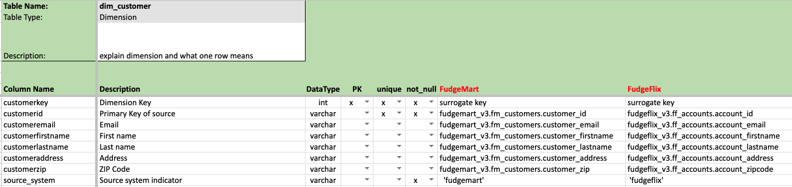
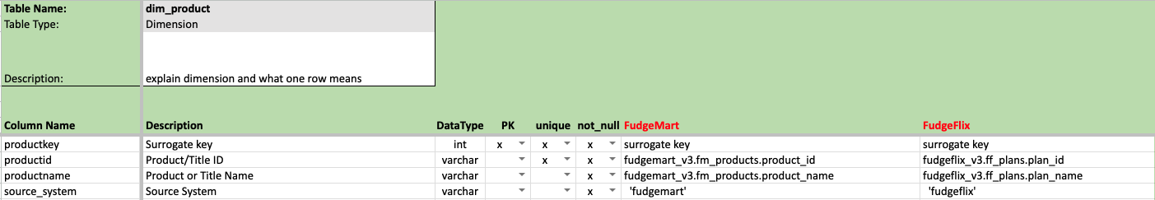
Detail Design

Slide 5
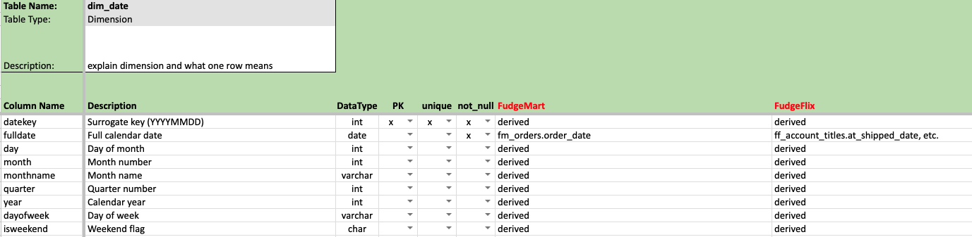
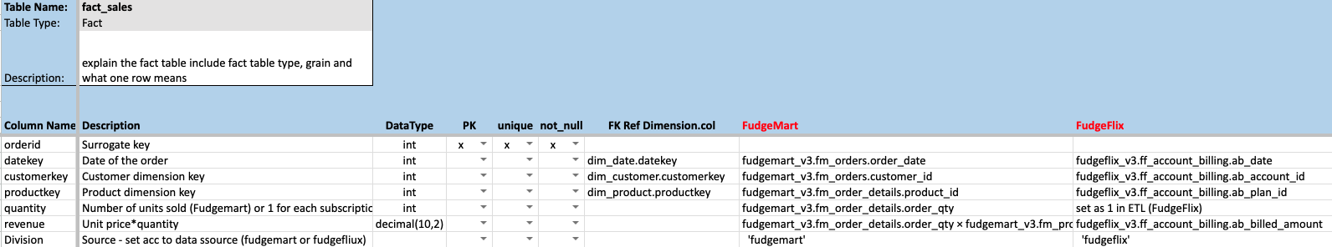
Detail Design

Slide 6
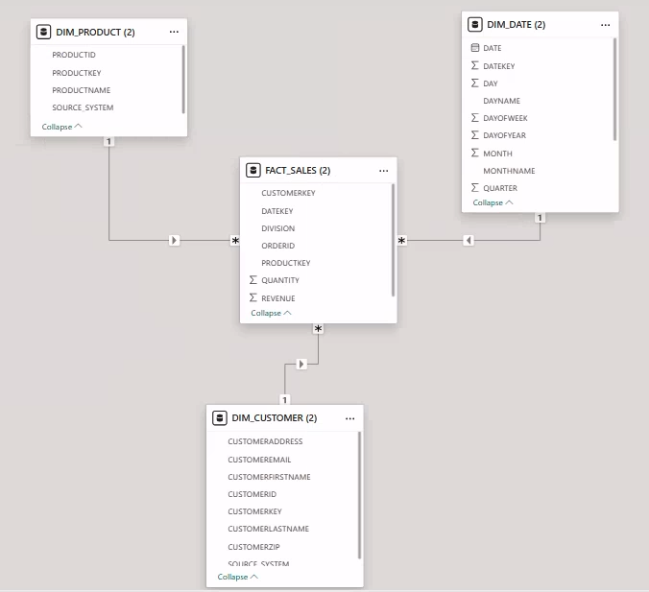
Star Schema Diagram
Schema Structure:
Fact Table:
FACT_SALES: Stores transaction-level data for both FudgeMart (retail) and FudgeFlix (movierental).
Dimension Tables:
DIM_CUSTOMER: Unified customer info (name, email, address, source).
DIM_PRODUCT: Common catalog of physical & digital products.
DIM_DATE:Standardized calendar used across both platforms for time based analysis.

Slide 7
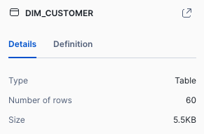
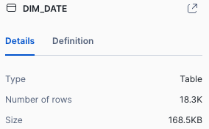
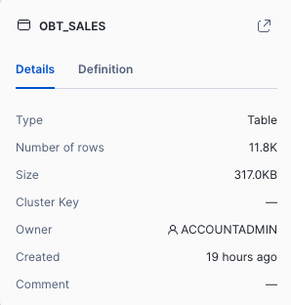
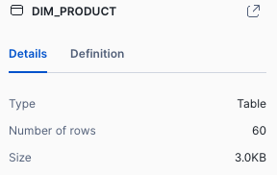
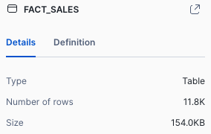
Summary of rows in each table of MarFlix DW

Slide 8
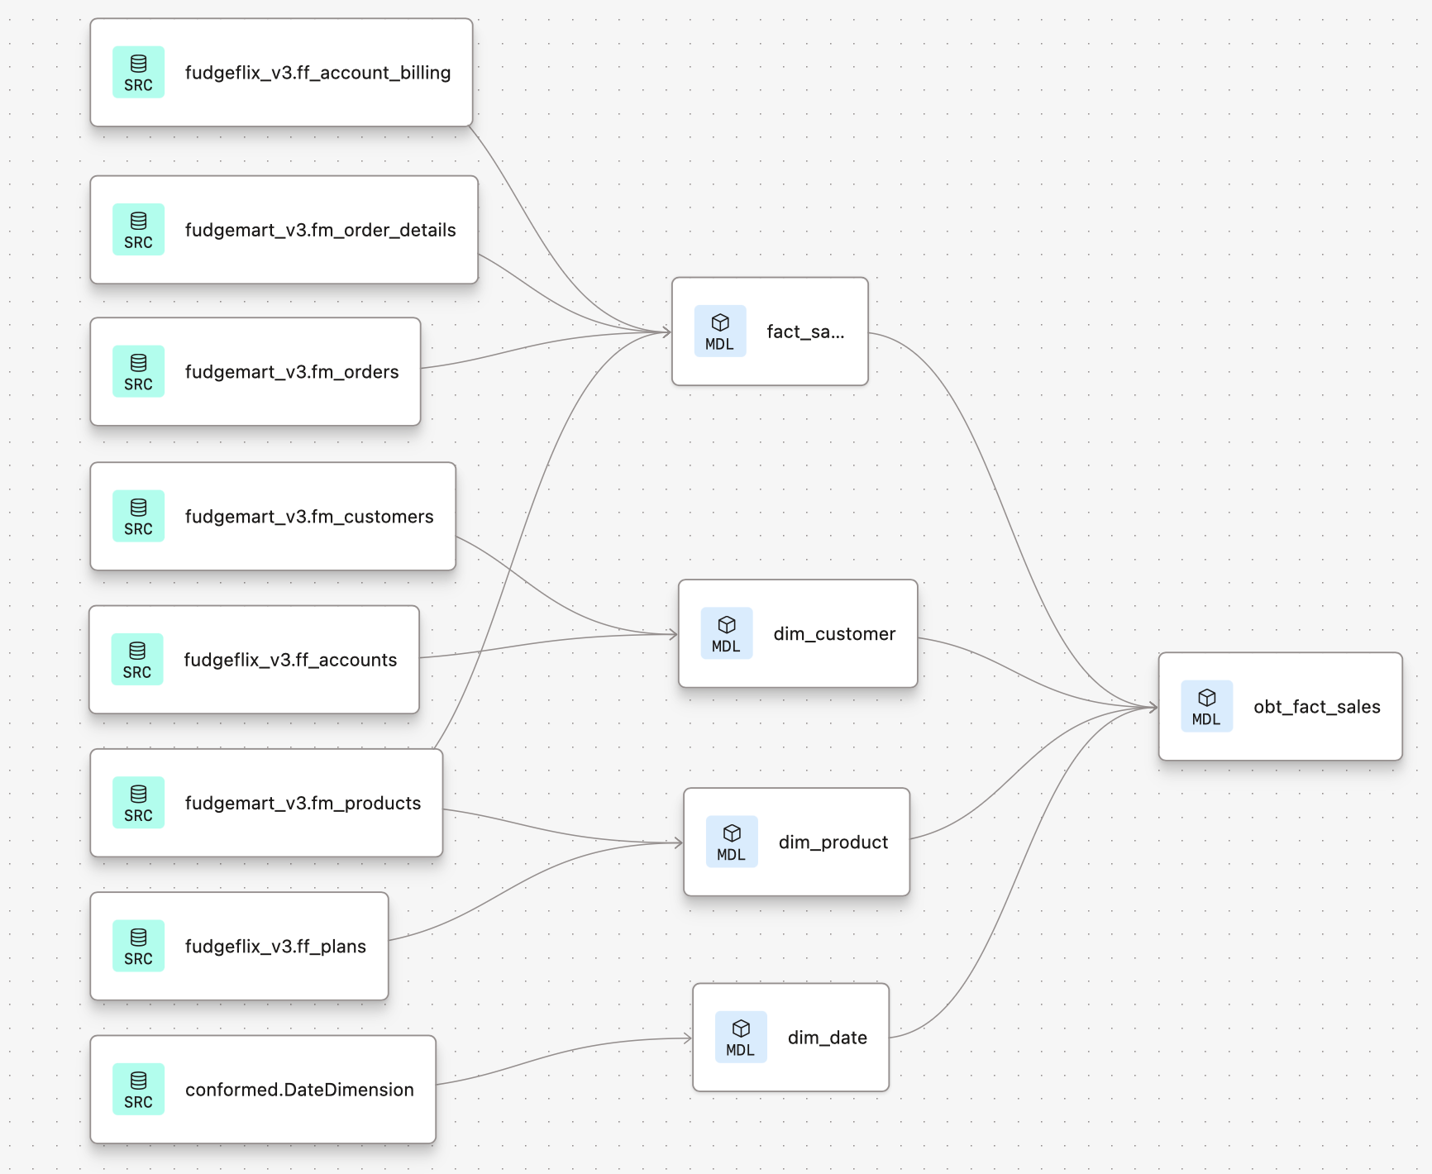
Data Lineage & dbt Model Dependency

Slide 9
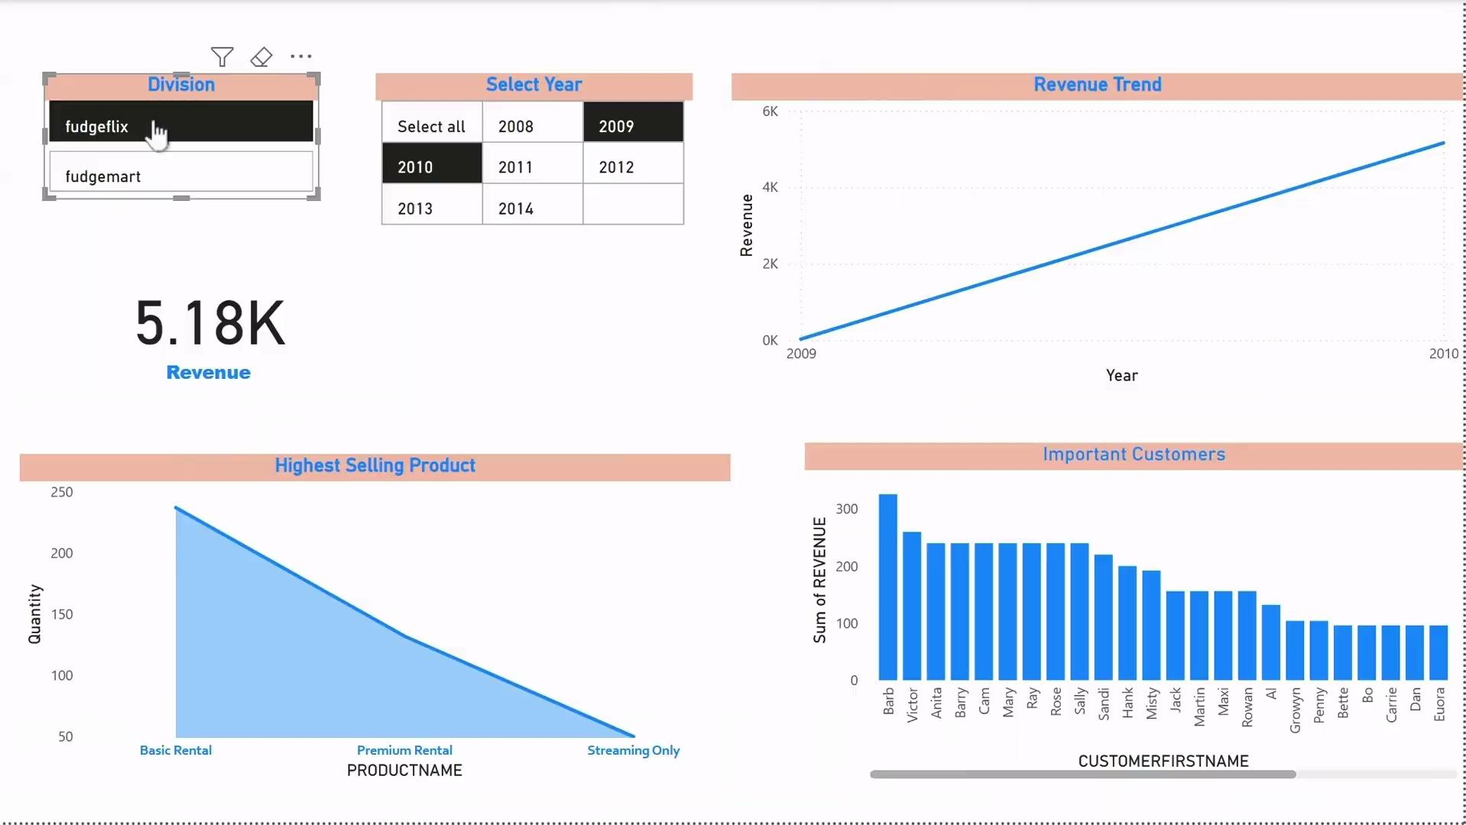
MarFlix Sales - PowerBI Dashboard
Overview:
Filter and compare sales performance by division and year
Track overall revenue trends over time
Identify top-selling products for each division
Highlight high-value customers driving significant revenue
Support strategic decisions on product performance, customer engagement, and year-over-year growth

Slide 10
Reflection
Lessons Learned:
Keep dbt sources and schema tests in lockstep with the SQL, our dim_date failed in the beginning because the source wasn’t declared and the YAML tested fulldate while the model actually selected date.
Ensure that the date dimension includes the full range of dates present in the fact table. Initially, our revenue trend visual was blank because the transaction dates in the fact table were missing from the date dimension. We resolved this by generating 50 years of dates in the date dimension to ensure proper alignment and accurate visualizations.
Future Considerations:
Standardize column naming and keys in a shared conventions doc so model SQL and YAML tests stay aligned as the project evolves.
Include more KPIs like profit margin, location wise sales .
Consider real time data source or scheduled refresh.

